Slide 1


Emotions, Self-Regulation Use, and Forecasting
Using Dynamic, Feature-Rich Stimuli
William Mitchell
Social Affective Neuroscience Lab
Temple University
Notes:
Hi everybody, Thank you so much for having me.
My name is Billy Mitchell I’m a PhD Candidate in Chelsea Helion’s SAN Lab at Temple University
and I’m going to talk a little bit about a project I’ve been working on for the last several years.
And I think a lot of the decisions we made in pursuing this project were inspired by and very much parallels much of the fantastic work that you all generate
It’s currently under review
So I’d love to hear your thoughts on it.
And lastly, please feel free to interrupt with questions and comments as I go through.

Slide 2
Notes:
So as I’m progressing through this talk today
hopefully one theme you’ll pick up
and something that was really central to the motivation for this project
is the difference between what we can maybe unofficially call theory

Slide 3
Theory
Notes:
and practice

Slide 4
Theory
Practice
Notes:
We can and most often do measure emotions and emotion regulation in ideal conditions, usually controlled isolated lab environments.

Slide 5
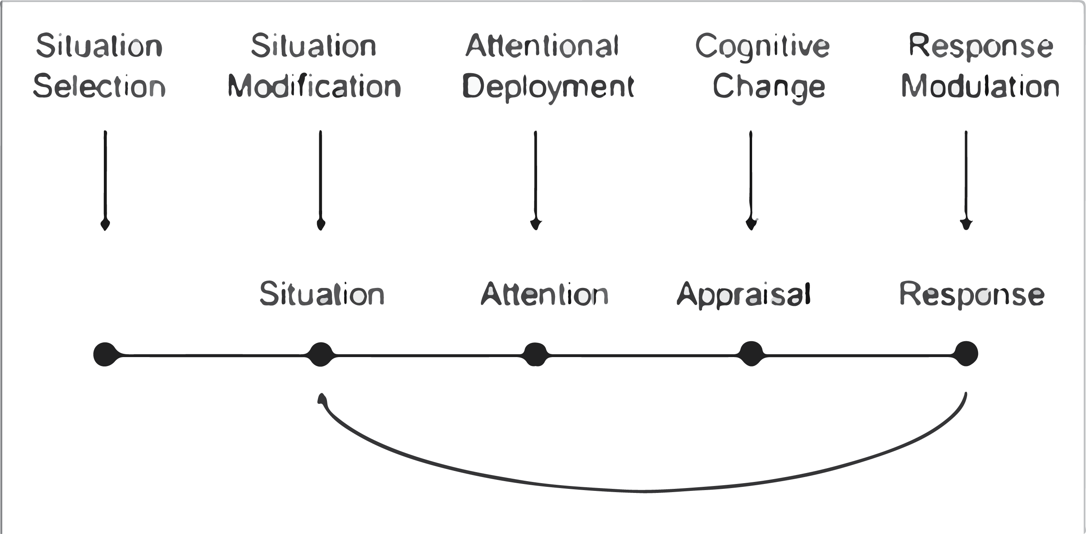
Theory
Practice
Process Model of Emotion Regulation
Gross, 1998
Notes:
The James Gross Process Model,
which is this notion that regulation can be categorized into different strategies based upon when in the time course of an event they are applied,
has been unbelievably generative and is has been often explored via stimulus-response paradigms

Slide 6
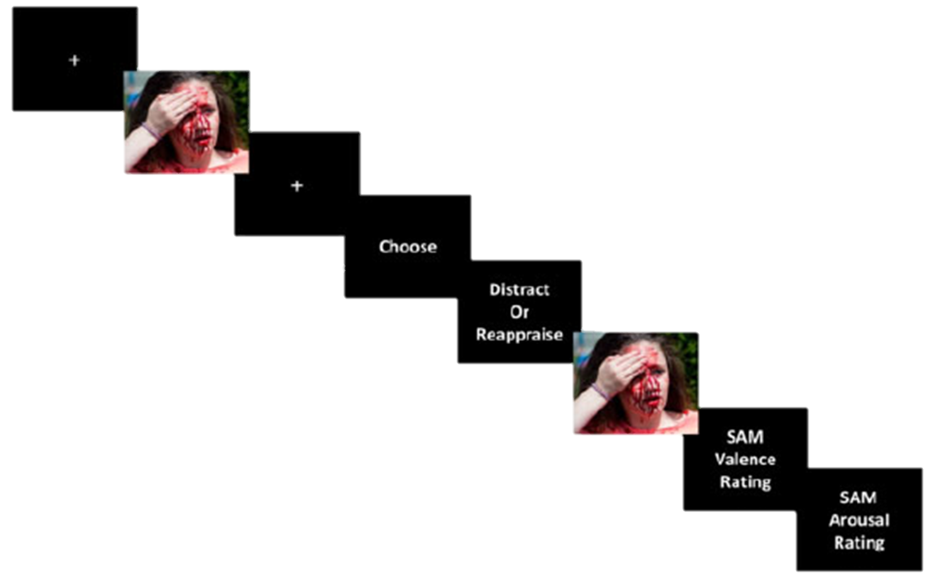
Theory
Practice
Process Model of Emotion Regulation
Stimulus-Response Emotion Regulation Paradigms
Gross, 1998
Sheppes et al., 2014
Notes:
During which participants are often first trained in different strategies,
shown a preview of an emotionally-evocative often negative, often unimodal stimulus,
prompted to regulate and choose between a circumscribed set of strategies,
Regulate their emotions,
and then report the effects of that self-regulation.

Slide 7
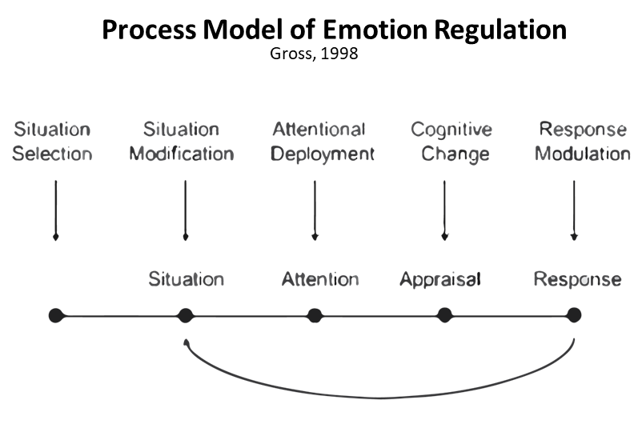
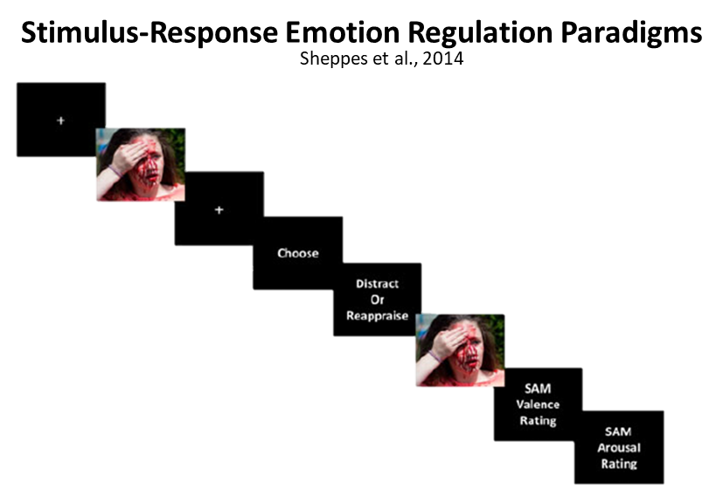
Theory
Practice
As emotional intensity increases, the probability of choosing Distraction instead of Reappraisal increases
r+ = 0.46 – 0.61; “a very large effect size” (Matthews et al., 2021)
Notes:
Through these types of paradigms, we’ve learned quite a bit about emotion regulation choice, For example, There appears to be a pretty robust relationship between how intense an emotional experience is
and which strategies someone might choose in this paradigm [CLICK]
But what still remains unclear

Slide 8
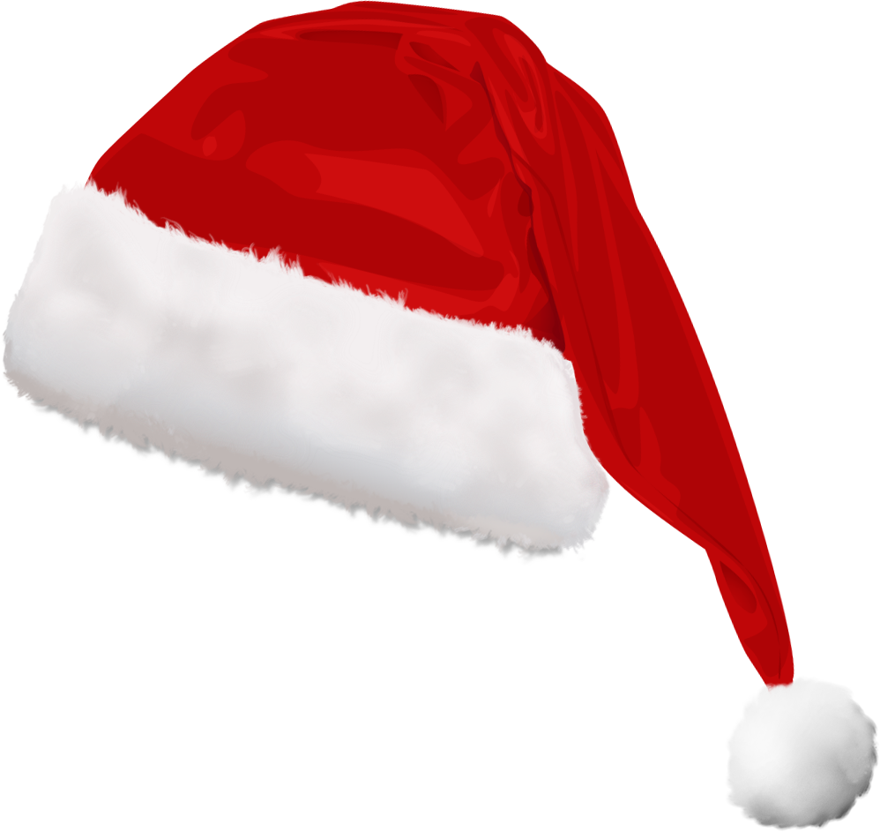
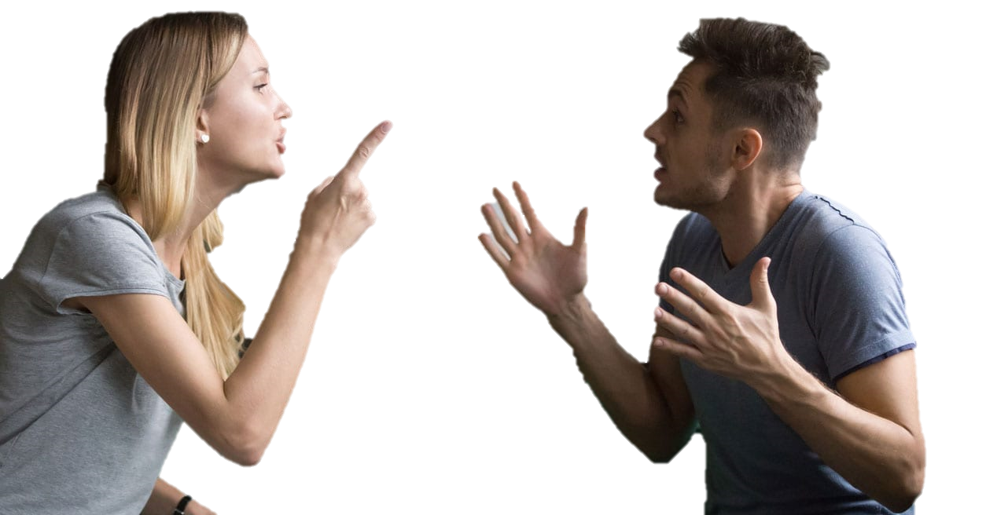
Theory
Practice
Notes:
Is if, for example,
You find tensions rising at your impending holiday family gathering

Slide 9


Theory
Practice
Notes:
Or if, god forbid, those social threats escalate to physical ones

Slide 10
Regulation
Choice
Regulation
Usage
Notes:
To what extent does what we choose reflect what we use.
Now obviously in these choice paradigms,
where we’re prioritizing high internal validity,
we’re going to hope that they possess some external validity as well.

Slide 11
Events in our lives can be:
Notes:
But there’s a lot of reasons that might not be true

Slide 12

Events in our lives can be:
Intense
Notes:
For one, the events in our lives where self-regulation can really matter
can be intense and aversive
and stimulus response paradigms can sometimes fall short here

Slide 13

Events in our lives can be:
Intense
Uncertain
Notes:
Events in our lives can be unpredictable,
making it difficult to adequately prepare an appropriate response.
We don’t often get explicitly prompted to self-regulate
Or training on strategies to self-regulate for that matter

Slide 14

Events in our lives can be:
Intense
Uncertain
Dynamic
Notes:
Events unfold over longer timecourses than we often can allow within our studies

Slide 15

Events in our lives can be:
Intense
Uncertain
Dynamic
Complex
Notes:
And lastly, events
and our response to those events
can be really complex.
Events can be compouned.
Sensations may be multimodal.
People may naturally be inclined to test multiple strategies, for example,
and we actually have seen evidence for this in studies that have relaxed the rules around how people regulate in the lab.

Slide 16
Events in our lives can be:
Intense
Uncertain
Dynamic
Complex
Notes:
Of course ecological momentary assessment approaches are incredibly valuable for addressing many of these concerns,
but thus far, many still train participants and encourage them to focus on emotion regulation.
They also can sometimes have little representation from intense aversive events,
again when self-regulation might be most important for safety or survival.

Slide 17
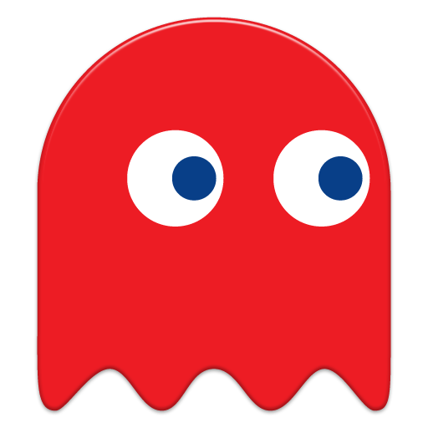
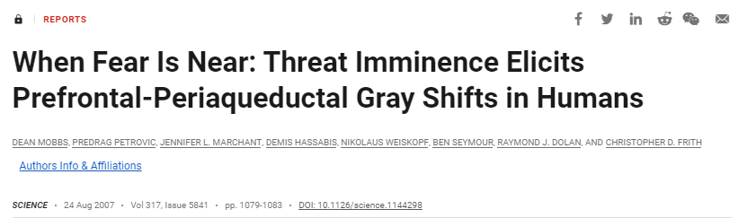


Notes:
There have been a lot of creative ways of modeling the complexity of emotion in controlled environments that address many of these concerns. The dean mobbs pac man shock experiment is a great example which has a very real physiological consequence for succumbing to or experiencing proximal and distal threats

Slide 18

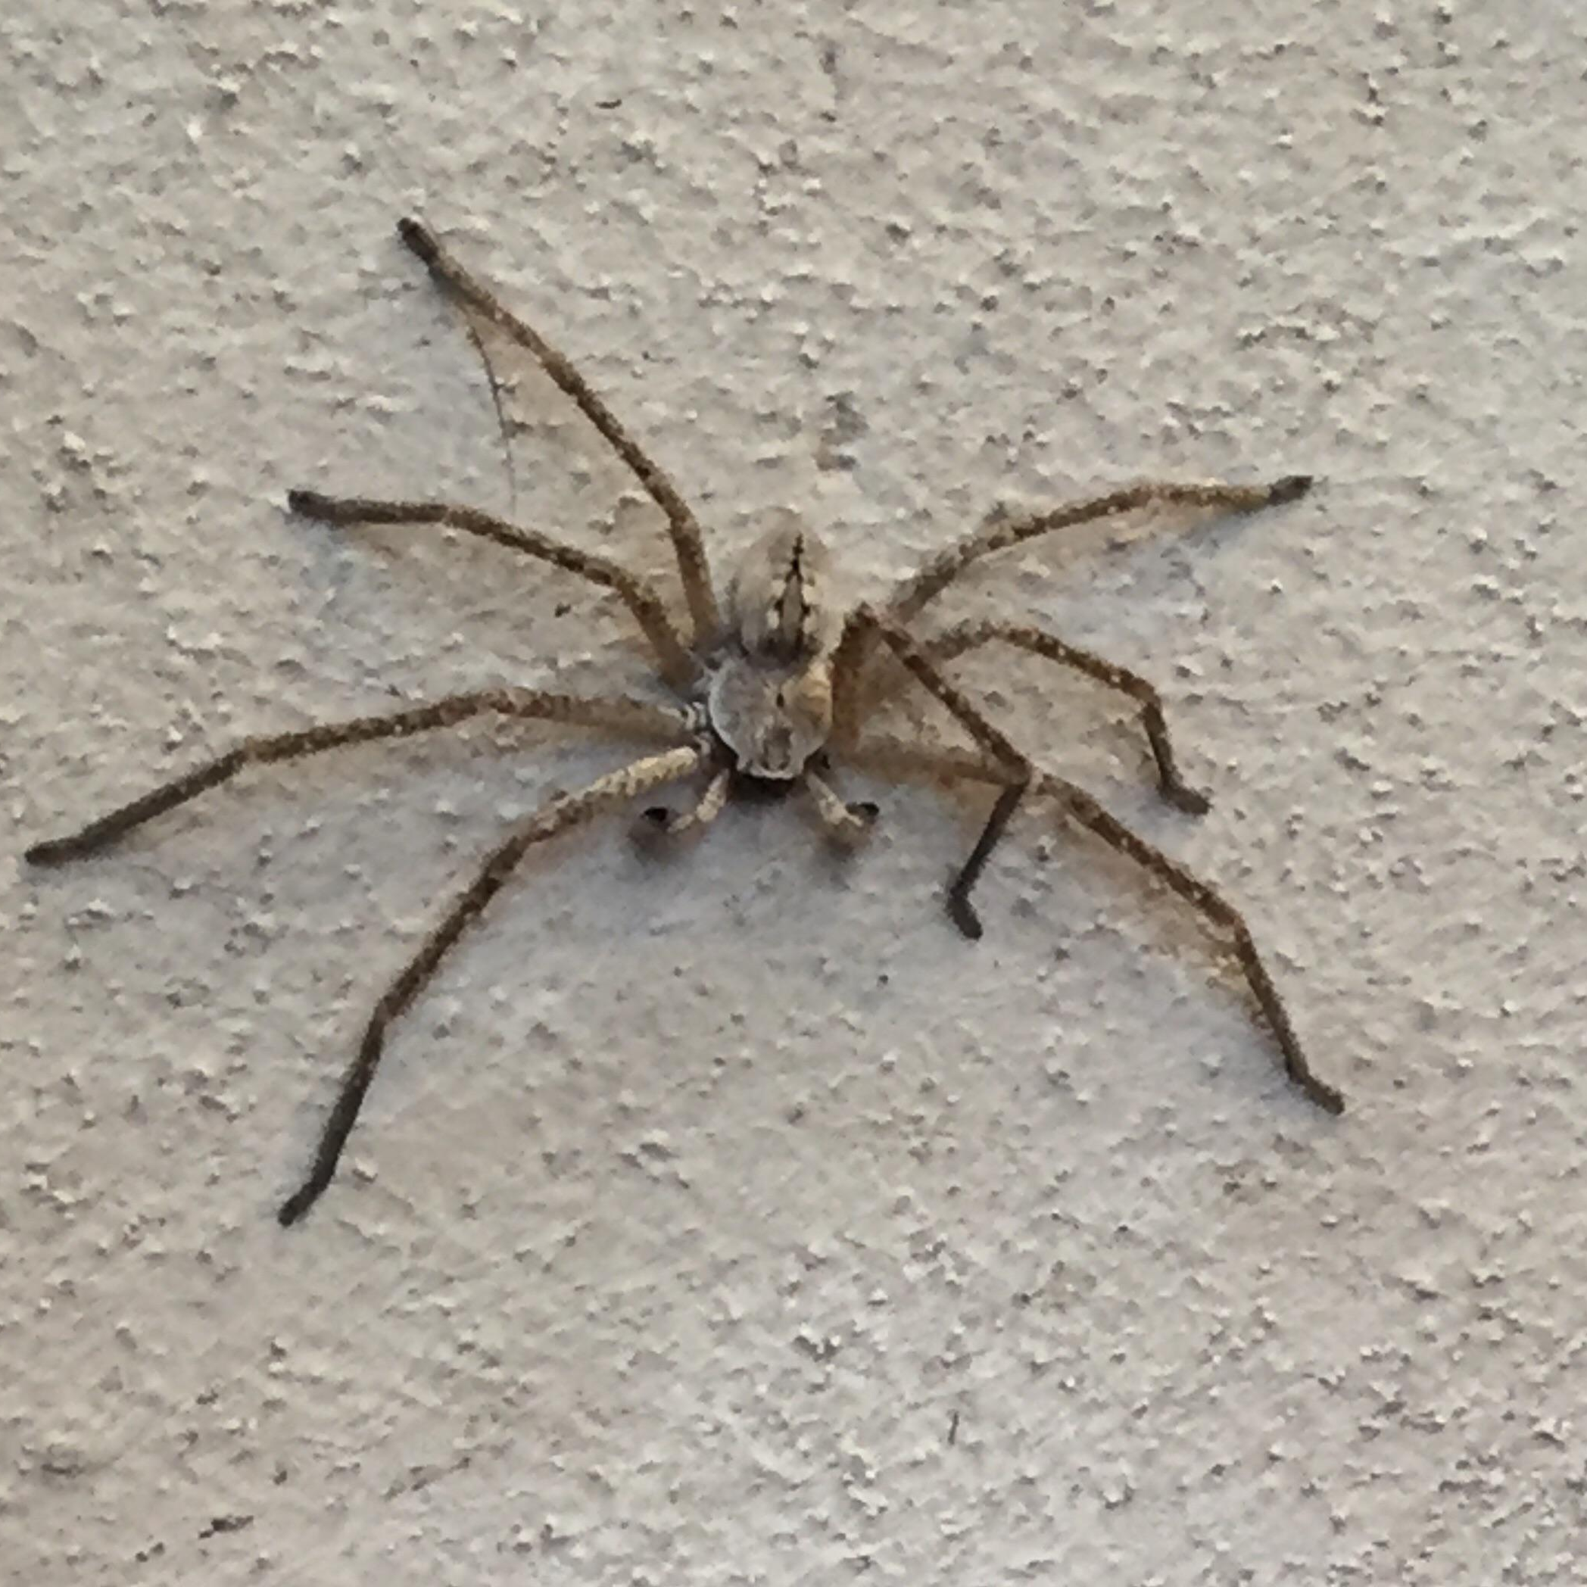
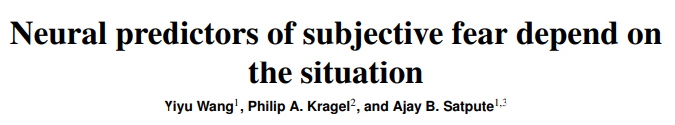

Notes:
Of course none of this is news for any of you either. You all have had paper after paper
highlighting interindividual variability in emotions
And intercontext variability in neural responses, which is the example I have shown here

Slide 19


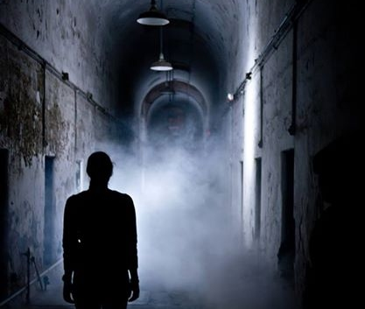
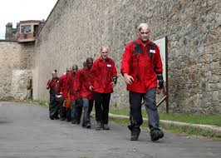
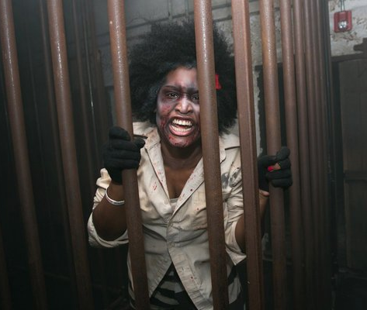
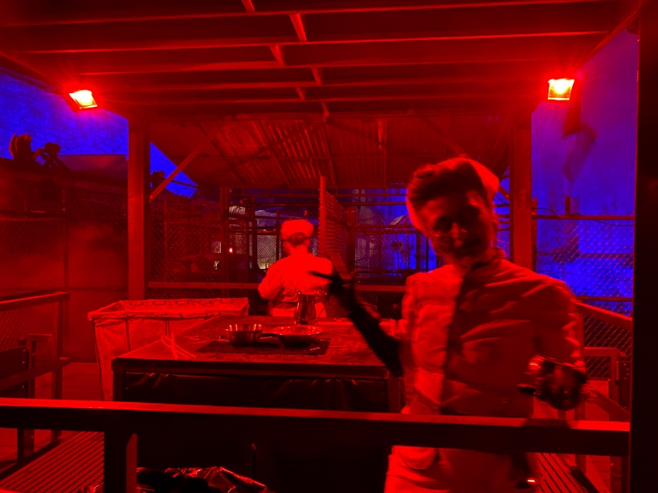
Notes:
and what I’ll talk to you all about today is what I think our attempt to contribute to this space has been Leveraging a couple different dynamic, feature-rich designs to capture emotion and emotion regulation
with a stronger focus on external or ecological validity.

Slide 20
What can Emotion Regulation Strategy Choice tell us about Use when events are intense, uncertain, dynamic, and complex?
Notes:
What I really wanted to do with this project was try to extend
the effects we see in the lab into quote unquote real world.
I wanted to see,
when I don’t train people,
when they aren’t constrained to two strategies,
when I don’t prompt them to regulate,
when they’re in really challenging circumstances,
will they self-regulate,
how will they self-regulate,
and what will influence their self-regulation?

Slide 21
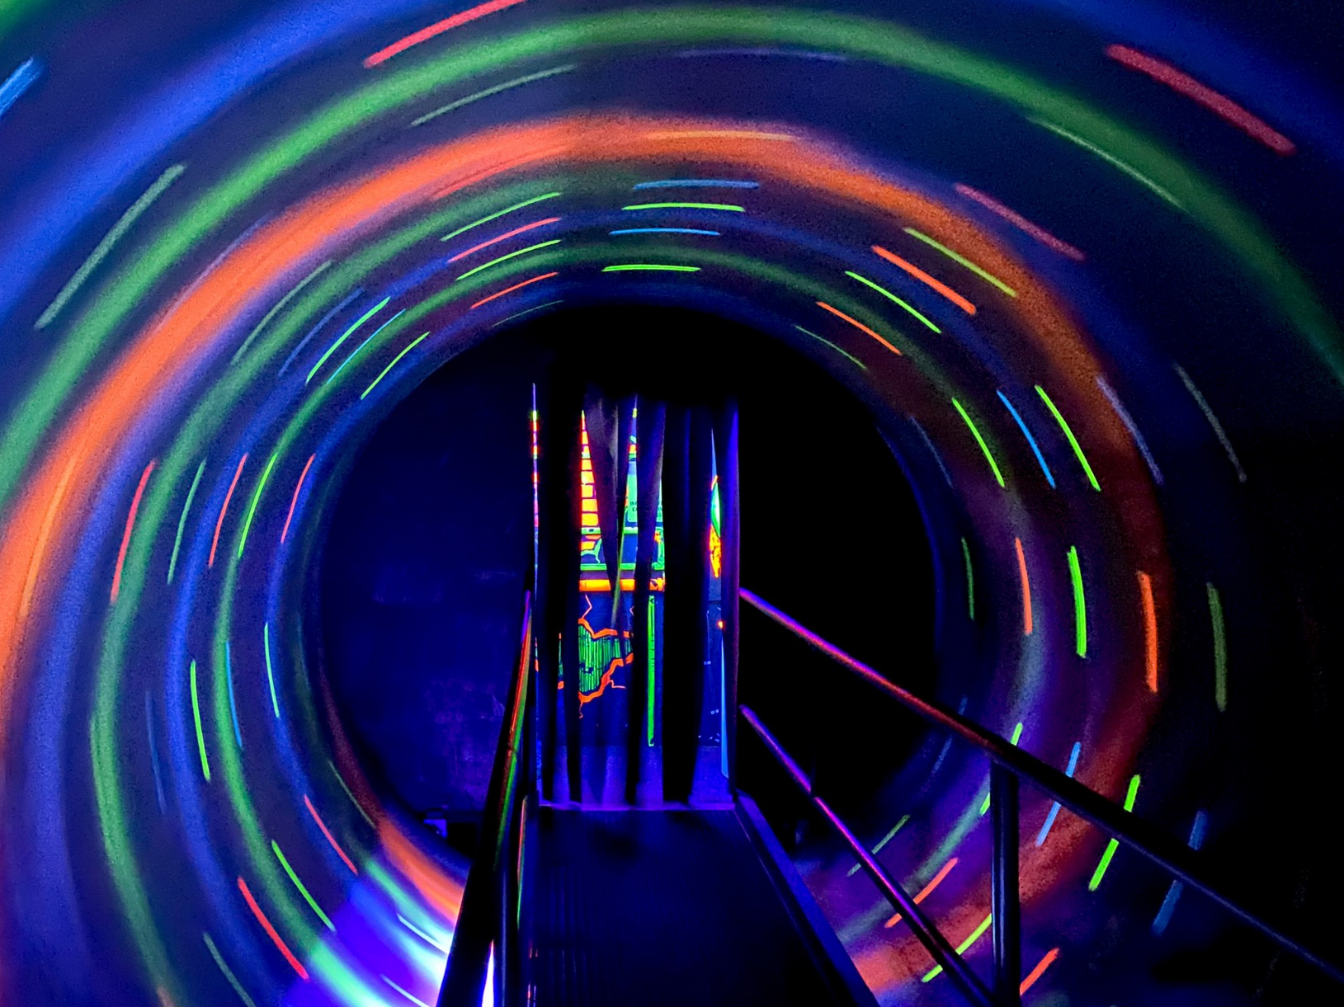

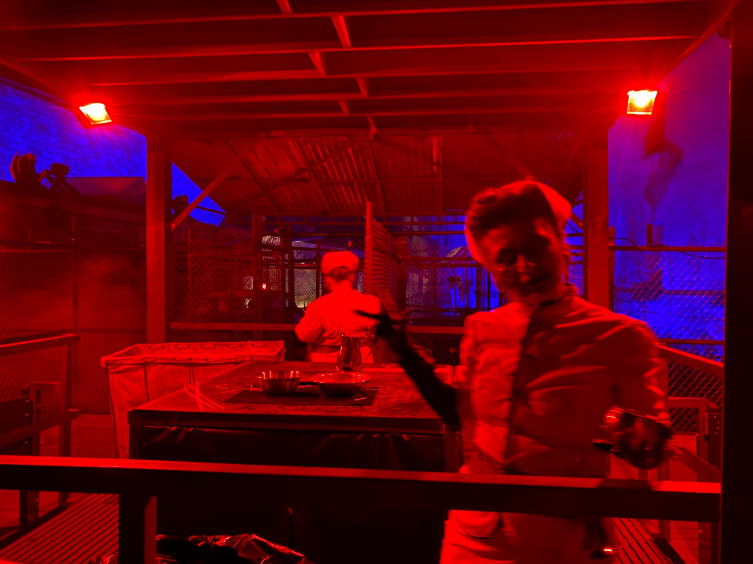
Notes:
For this, we used a haunted house experience because it incorporates all of the features that are otherwise hard to fit in a lab experiment.

Slide 22
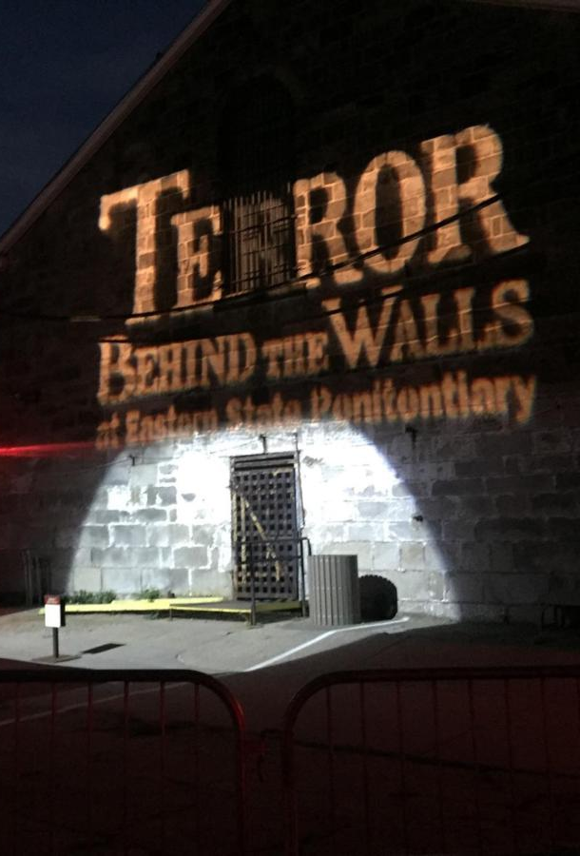
What can TBTW offer?
Feature-rich but relatively controlled environment
Notes:
The environment can feel really overwhelming and chaotic, but it is completely controlled.
Participants can feel in danger without being in any real danger.
Participants can also experience a wide range of emotions – not just “negative” ones

Slide 23
What can TBTW offer?
Feature-rich but relatively controlled environment
Limited researcher intervention
Notes:
Relatedly, it can be very easy to forget that you are participating in a study at terror behind the walls.
we did not need a lot of researcher participant interaction during exposure
And our participants could focus on trying to have as typical of a response as the situation would allow

Slide 24
What can TBTW offer?
Feature-rich but relatively controlled environment
Limited researcher intervention
Performances are reliably consistent
Notes:
The TBTW team let our participants skip lines to ensure that
all of their highly trained professional actors were in the same marks every time
Minimizing differences in experiences

Slide 25
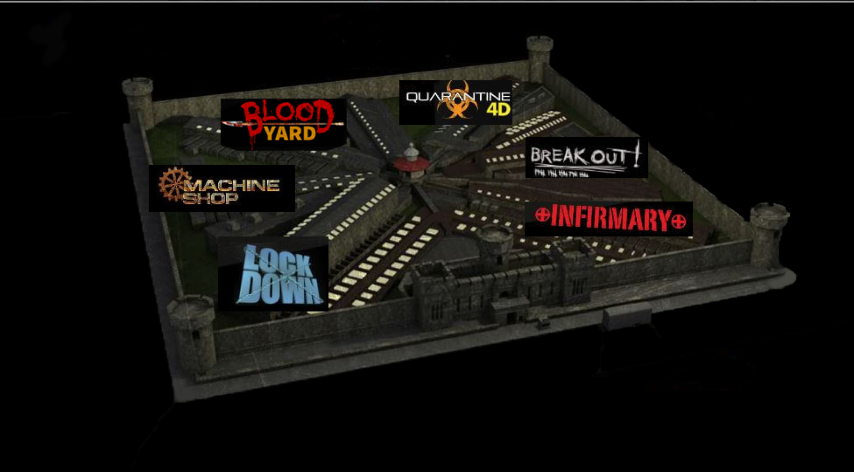
What can TBTW offer?
Feature-rich but relatively controlled environment
Limited researcher intervention
Performances are reliably consistent
Great stimuli variability
Notes:
And there were themed sections which offered a wide variety of stimuli to elicit emotions

Slide 26
Pilot
(N = 58)
Study 2
(N = 154)
Study 1
(N = 118)
Study 3
(N = 253)
Notes:
So the first thing we did in 2019 was a pilot study in which participants traversed the full 45 minute haunted house experience
We based our a priori power analysis on the most conservative effect size that we could observe at the time,
which suggested that we should be able to sufficiently power this study with just 18 participants.
Obviously given the additional complications
and the fact that others had questions that required greater power,
we aimed for 60 participants and got 58.

Slide 27
Pilot
(N = 58)
Study 2
(N = 154)
Instructed to experience haunted house naturally
No emotion regulation training
Identified ten most emotionally-salient events
Recorded affective intensity, regulation effort and described strategy in their own words for each event
Strategies were coded (IRR = 0.881)
Study 1
(N = 118)
Study 3
(N = 253)
Notes:
These participants were given minimal instructions and information before entering the haunted house.

Slide 28
Pilot
(N = 58)
Study 2
(N = 154)
Instructed to experience haunted house naturally
No emotion regulation training
Identified ten most emotionally-salient events
Recorded affective intensity, regulation effort and described strategy in their own words for each event
Strategies were coded (IRR = 0.881)
Study 1
(N = 118)
Study 3
(N = 253)
Notes:
Emotion regulation was never mentioned and participants were not trained in strategies

Slide 29
Pilot
(N = 58)
Study 2
(N = 154)
Instructed to experience haunted house naturally
No emotion regulation training
Identified ten most emotionally-salient events
Recorded affective intensity, regulation effort and described strategy in their own words for each event
Strategies were coded (IRR = 0.881)
Study 1
(N = 118)
Study 3
(N = 253)
Notes:
Instead, after the full experience,
participants were asked to self-identify ten events from the haunted house
that were most emotionally salient to them

Slide 30
Pilot
(N = 58)
Study 2
(N = 154)
Instructed to experience haunted house naturally
No emotion regulation training
Identified ten most emotionally-salient events
Recorded affective intensity, regulation effort and described strategy in their own words for each event
Strategies were coded (IRR = 0.881)
Study 1
(N = 118)
Study 3
(N = 253)
Notes:
They identified which emotions they felt from 14 options sourced from the PANAS,
how intense they felt those emotions,
and then, in a free response box,
were asked to describe how they attempted to self-regulate those emotions if they did at all.
They also completed a number of individual difference measures.

Slide 31
Pilot
(N = 58)
Study 2
(N = 154)
Instructed to experience haunted house naturally
No emotion regulation training
Identified ten most emotionally-salient events
Recorded affective intensity, regulation effort and described strategy in their own words for each event
Strategies were coded (IRR = 0.881)
Study 1
(N = 118)
Study 3
(N = 253)
Notes:
[ Wanted to explore the relationship between usage and intensity (highlight red ring)
Talk about this happening in parallel with memory research which limited my ability to take away reliable findings, but it did at least verify that this paradigm would work ]

Slide 32
When feeling intense emotions, people self-regulated
People who do not enjoy haunted houses regulate more events within the haunted house. r² adj. = 0.242

Slide 33
When feeling intense emotions, people self-regulated
People who do not enjoy haunted houses regulate more events within the haunted house. r² adj. = 0.242

Slide 34
When feeling intense emotions, people self-regulated
People who do not enjoy haunted houses regulate more events within the haunted house. r² adj. = 0.242
As startle sensitivity increases, the number of regulated events within the haunted house increases. r² adj. = 0.085

Slide 35
When feeling intense emotions, people self-regulated
People who do not enjoy haunted houses regulate more events within the haunted house. r² adj. = 0.242
As startle sensitivity increases, the number of regulated events within the haunted house increases. r² adj. = 0.085

Slide 36
When feeling intense emotions, people self-regulated
People who do not enjoy haunted houses regulate more events within the haunted house. r² adj. = 0.242
As startle sensitivity increases, the number of regulated events within the haunted house increases. r² adj. = 0.085
As anxiety increased within the haunted house, so did participants’ self-reported efforts to emotionally regulate. r² adj. = 0.095

Slide 37
When feeling intense emotions, people self-regulated
People who do not enjoy haunted houses regulate more events within the haunted house. r² adj. = 0.242
As startle sensitivity increases, the number of regulated events within the haunted house increases. r² adj. = 0.085
As anxiety increased within the haunted house, so did participants’ self-reported efforts to emotionally regulate. r² adj. = 0.095

Slide 38
When feeling intense emotions, people self-regulated
People who do not enjoy haunted houses regulate more events within the haunted house. r² adj. = 0.242
As startle sensitivity increases, the number of regulated events within the haunted house increases. r² adj. = 0.085
As anxiety increased within the haunted house, so did participants’ self-reported efforts to emotionally regulate. r² adj. = 0.095
As negative affective intensity increased, people put more effort towards regulating their emotions.

Slide 39
When feeling intense emotions, people self-regulated
People who do not enjoy haunted houses regulate more events within the haunted house. r² adj. = 0.242
As startle sensitivity increases, the number of regulated events within the haunted house increases. r² adj. = 0.085
As anxiety increased within the haunted house, so did participants’ self-reported efforts to emotionally regulate. r² adj. = 0.095
As negative affective intensity increased for a given event, people put more effort towards regulating their emotions during that event.

Slide 40
Pilot
(N = 58)
Study 2
(N = 154)
Largely the same as Pilot except no time lag
Emotions were also free-response
Strategies were coded again (IRR = 0.877)
Instructed to experience haunted house naturally
No emotion regulation training
Identified ten most emotionally-salient events
Recorded affective intensity, regulation effort and described strategy in their own words for each event
Strategies were coded (IRR = 0.881)
Study 1
(N = 118)
Study 3
(N = 253)
Notes:
We did not find the canonical association between affective intensity and strategy usage, but again there were a lot of confounds that might have explained that. In 2021, we ran it again with changes.
We included 118 people
Using observed effect from pilot
[No time lag]

Slide 41
Pilot
(N = 58)
Study 2
(N = 154)
Largely the same as Pilot except no time lag
Emotions were also free-response
Strategies were coded again (IRR = 0.877)
Instructed to experience haunted house naturally
No emotion regulation training
Identified ten most emotionally-salient events
Recorded affective intensity, regulation effort and described strategy in their own words for each event
Strategies were coded (IRR = 0.881)
Study 1
(N = 118)
Study 3
(N = 253)
Notes:
[We took an approach with less researcher bias]

Slide 42
Pilot
(N = 58)
Study 2
(N = 154)
Largely the same as Pilot except no time lag
Emotions were also free-response
Strategies were coded again (IRR = 0.877)
Instructed to experience haunted house naturally
No emotion regulation training
Identified ten most emotionally-salient events
Recorded affective intensity, regulation effort and described strategy in their own words for each event
Strategies were coded (IRR = 0.881)
Study 1
(N = 118)
Study 3
(N = 253)

Slide 43
We are certainly self-regulating, but how we do so is complicated ...
Affective intensity did not predict which strategy participants used when regulating their emotions in this context.

Slide 44
We are certainly self-regulating, but how we do so is complicated ...
Affective intensity did not predict which strategy participants used when regulating their emotions in this context.

Slide 45
We are certainly self-regulating, but how we do so is complicated ...
Affective intensity did not predict which strategy participants used when regulating their emotions in this context.
This was true even when taking a multiverse approach and adjusting for known covariates including cognitive load, sex, and ERQ scores.

Slide 46
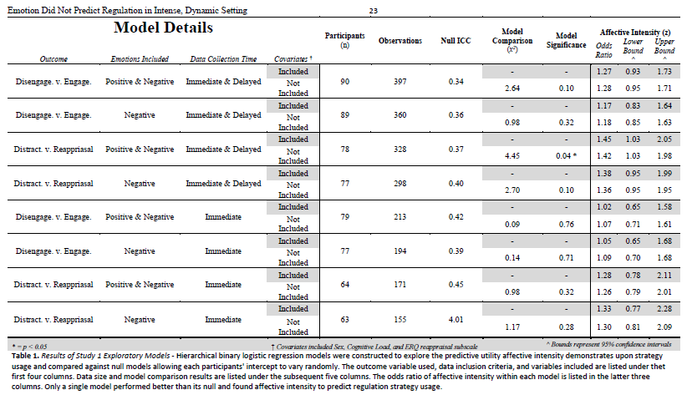
Notes:
[ Note I forgot to include the multiple comparisons adjustment here, none of these survived]

Slide 47
At least part of the reason that it may be complicated is that ...
Reappraisal performed about evenly at all levels of intensity, while distraction got worse as intensity increases
This is contrary to what previous lab research might suggest

Slide 48
At least part of the reason that it may be complicated is that ...
Reappraisal performed about evenly at all levels of intensity, while distraction got worse as intensity increases
This is contrary to what previous lab research might suggest

Slide 49
Regulation Strategy Choice
Regulation Strategy Use

Slide 50

Regulation Strategy Choice
Regulation Strategy Use
Regulation Strategy Forecasting
Notes:
Existing somewhere in between having characteristics of each

Slide 51
If Use doesn’t match Choice,
which is Forecasting more similar to?

Slide 52
Pilot
(N = 58)
Study 2
(N = 154)
Largely the same as Pilot except no time lag
Emotions were also free-response
Strategies were coded again (IRR = 0.877)
Instructed to experience haunted house naturally
No emotion regulation training
Identified ten most emotionally-salient events
Recorded affective intensity, regulation effort and described strategy in their own words for each event
Strategies were coded (IRR = 0.881)
Conducted entirely online with people who had never seen the haunted house
Fed descriptions of events, affective information,
Asked to predict which strategy they would have used.
More closely mirrors the stimulus-response paradigms
Study 1
(N = 118)
Study 3
(N = 253)

Slide 53
Pilot
(N = 58)
Study 2
(N = 154)
Largely the same as Pilot except no time lag
Emotions were also free-response
Strategies were coded again (IRR = 0.877)
Instructed to experience haunted house naturally
No emotion regulation training
Identified ten most emotionally-salient events
Recorded affective intensity, regulation effort and described strategy in their own words for each event
Strategies were coded (IRR = 0.881)
Conducted entirely online with people who had never seen the haunted house
Fed descriptions of events, affective information
Asked to predict which strategy they would have used.
More closely mirrors the stimulus-response paradigms
Study 1
(N = 118)
Study 3
(N = 253)

Slide 54
Pilot
(N = 58)
Study 2
(N = 154)
Largely the same as Pilot except no time lag
Emotions were also free-response
Strategies were coded again (IRR = 0.877)
Instructed to experience haunted house naturally
No emotion regulation training
Identified ten most emotionally-salient events
Recorded affective intensity, regulation effort and described strategy in their own words for each event
Strategies were coded (IRR = 0.881)
Conducted entirely online with people who had never seen the haunted house
Fed descriptions of events, affective information
Asked to predict which strategy they would have used.
More closely mirrors the stimulus-response paradigms
Study 1
(N = 118)
Study 3
(N = 253)

Slide 55
Pilot
(N = 58)
Study 2
(N = 154)
Largely the same as Pilot except no time lag
Emotions were also free-response
Strategies were coded again (IRR = 0.877)
Instructed to experience haunted house naturally
No emotion regulation training
Identified ten most emotionally-salient events
Recorded affective intensity, regulation effort and described strategy in their own words for each event
Strategies were coded (IRR = 0.881)
Conducted entirely online with people who had never seen the haunted house
Fed descriptions of events, affective information
Asked to predict which strategy they would have used.
More closely mirrors the stimulus-response paradigms
Study 1
(N = 118)
Study 3
(N = 253)

Slide 57
When forecasting emotion regulation ...
We see a similar pattern of results to what ER researchers have canonically found (albeit, a much weaker association); increased affective intensity predicts a greater likelihood of selecting distraction instead of reappraisal
OR = 1.06, 95% CI = [1.02, 1.10], p = 0.004

Slide 58
When forecasting emotion regulation ...
We see a similar pattern of results to what ER researchers have canonically found (albeit, a much weaker association); increased affective intensity predicts a greater likelihood of selecting distraction instead of reappraisal
OR = 1.06, 95% CI = [1.02, 1.10], p = 0.004
These differences were not explained by differences between the samples in ERQ, DERS, or IUS

Slide 59
When forecasting emotion regulation ...
We see a similar pattern of results to what ER researchers have canonically found (albeit, a much weaker association); increased affective intensity predicts a greater likelihood of selecting distraction instead of reappraisal
OR = 1.06, 95% CI = [1.02, 1.10], p = 0.004
These differences were not explained by differences between the samples in ERQ, DERS, or IUS
Forecasters matched Reappraisal at about chance. However, forecasters were much less accurate in matching Distraction, adjusting for frequency differences.
Notes:
likely because Forecasters were specifically using the strategy at higher intensities; the situation which experiencers found themselves the least likely to successfully deploy distraction.
which might makes sense if we have one group effectively choosing reappraisal at chance

Slide 60

Pilot
(N = 58)
Study 2
(N = 154)
Largely the same as Pilot except no time lag
Emotions were also free-response
Strategies were coded again (IRR = 0.877)
Instructed to experience haunted house naturally
No emotion regulation training
Identified ten most emotionally-salient events
Recorded affective intensity, regulation effort and described strategy in their own words for each event
Strategies were coded (IRR = 0.881)
Conducted entirely online with people who had never seen the haunted house
Fed descriptions of events, affective information,
Asked to predict which strategy they would have used.
More closely mirrors the stimulus-response paradigms
Study 1
(N = 118)
Study 3
(N = 253)

Slide 61
Pilot
(N = 58)
Study 2
(N = 154)
Largely the same as Pilot except no time lag
Emotions were also free-response
Strategies were coded again (IRR = 0.877)
Conducted online using horror movie stimuli
Seeks to disentangle the forecasting/experiencing and stimulation –level
confound
Instructed to experience haunted house naturally
No emotion regulation training
Identified ten most emotionally-salient events
Recorded affective intensity, regulation effort and described strategy in their own words for each event
Strategies were coded (IRR = 0.881)
Conducted entirely online with people who had never seen the haunted house
Fed descriptions of events, affective information,
Asked to predict which strategy they would have used.
More closely mirrors the stimulus-response paradigms
Study 1
(N = 118)
Study 3
(N = 253)

Slide 62
Pilot
(N = 58)
Study 2
(N = 154)
Largely the same as Pilot except no time lag
Emotions were also free-response
Strategies were coded again (IRR = 0.877)
Conducted online using horror movie stimuli
Captured both forecasting and experiencing usage using high and low intensity stimuli
Instructed to experience haunted house naturally
No emotion regulation training
Identified ten most emotionally-salient events
Recorded affective intensity, regulation effort and described strategy in their own words for each event
Strategies were coded (IRR = 0.881)
Conducted entirely online with people who had never seen the haunted house
Fed descriptions of events, affective information,
Asked to predict which strategy they would have used.
More closely mirrors the stimulus-response paradigms
Study 1
(N = 118)
Study 3
(N = 253)

Slide 63
Pilot
(N = 58)
Study 2
(N = 154)
Largely the same as Pilot except no time lag
Emotions were also free-response
Strategies were coded again (IRR = 0.877)
Conducted online using horror movie stimuli
Captured both forecasting and experiencing usage using high and low intensity stimuli
Mirrored many aspects of Study 1
Instructed to experience haunted house naturally
No emotion regulation training
Identified ten most emotionally-salient events
Recorded affective intensity, regulation effort and described strategy in their own words for each event
Strategies were coded (IRR = 0.881)
Conducted entirely online with people who had never seen the haunted house
Fed descriptions of events, affective information,
Asked to predict which strategy they would have used.
More closely mirrors the stimulus-response paradigms
Study 1
(N = 118)
Study 3
(N = 253)

Slide 64
When comparing usage and forecasting in more controlled circumstances...
At lower intensities, forecasters are less likely to select reappraisal than experiencers were to use reappraisal.
OR = 0.61, 95% CI = [0.39, 0.95], p = 0.029

Slide 65
When comparing usage and forecasting in more controlled circumstances...
At lower intensities, forecasters are less likely to select reappraisal than experiencers were to use reappraisal.
OR = 0.61, 95% CI = [0.39, 0.95], p = 0.029

Slide 66
When comparing usage and forecasting in more controlled circumstances...
[
At lower intensities, forecasters are less likely to select reappraisal than experiencers were to use reappraisal.
OR = 0.61, 95% CI = [0.39, 0.95], p = 0.029

Slide 67
***
When comparing usage and forecasting in more controlled circumstances...
At lower intensities, forecasters are less likely to select reappraisal than experiencers were to use reappraisal.
OR = 0.61, 95% CI = [0.39, 0.95], p = 0.029
Forecasters were much more likely to select regulation over forecasters

Slide 68
When comparing usage and forecasting in more controlled circumstances...
**
At lower intensities, forecasters are less likely to select reappraisal than experiencers were to use reappraisal.
OR = 0.61, 95% CI = [0.39, 0.95], p = 0.029
Forecasters were much more likely to select regulation over forecasters
However, forecasters used the strategies much more evenly than did experiencers, who relied more on reappraisal.

Slide 69
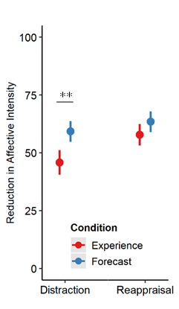
When comparing usage and forecasting in more controlled circumstances...
Forecasters predicted that distraction would reduce affective intensity when used more than experiencers reported that it actually had.
x̄ _{Experience} = 48.0 | x̄ _{Forecast} = 58.3
95% CI = [-16.62, -4.13]
t(198.2) = -3.28, p = 0.001

Slide 70
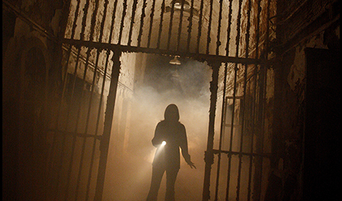
When events are …
Aversive
Uncertain
Dynamic
Complex
People spontaneously self-regulated their emotions
How people self-regulate their emotions is not significantly predicted by individual differences, affective intensity, cognitive load, or any other factor we commonly examine in the lab
Forecasting may still reflect the canonical regulation relationships, which raises questions of how environmental affordances, such as time to process, influence everyday self-regulation
Distraction was consistently less effective in use than might be expected by choice paradigms or forecasters.
Notes:
[ Talk about prediction gaps,
talk about environmental affordances,
talk about the influence of context,

Slide 71

Notes:
But I should also be very up front about our limitations

Slide 72
Self-selection bias
Notes:
We cannot deny the likelihood that some self-selection bias was at play here.
We tried our best to monitor this and test this. We did find quite a bit of diversity in the distribution of participant responses to questions like “How much do you enjoy or are fearful of haunted houses?”
We captured participant expectations and motivations for participation. But no matter what

Slide 73
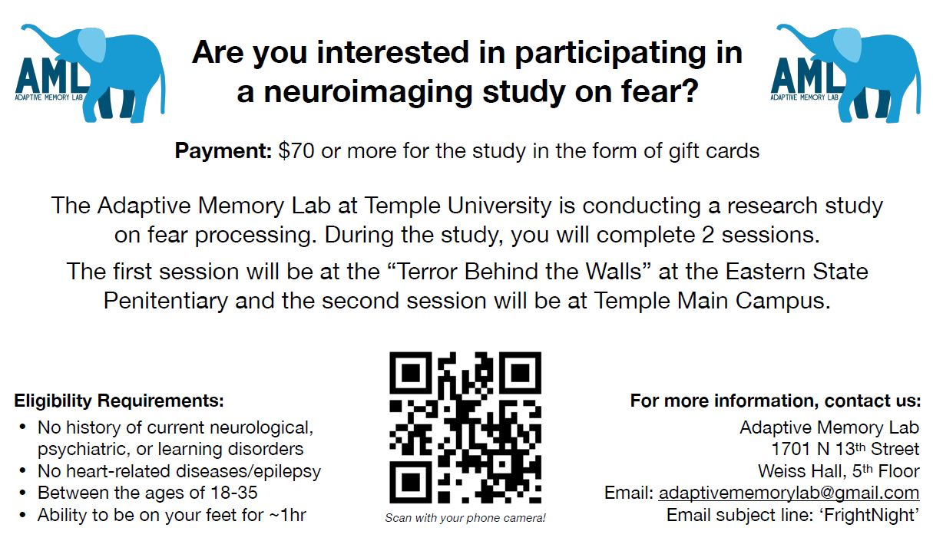
Notes:
When you advertise for a study on fear at a nationally famous haunted house
You have to assume certain types of participants are not responding to the ad

Slide 74
Self-selection bias
Still an artificial setting that might not generalize to daily life
Notes:
Although I believe that this design incorporates many of those features that I think to be important, it still is a fundamentally artificial environment.
When describing it, I’m hesitant to call it quasi-naturalistic and in fact often prefer something like “Dynamic and Feature-rich”

Slide 75

Self-selection bias
Still an artificial setting that might not generalize to daily life
Very resource intensive
Notes:
This was also a very resource intensive project which would not be possible without us being a very fortunate position to have received NSF funding for this project

Slide 76
Self-selection bias
Still an artificial setting that might not generalize to daily life
Very resource intensive
Difficult to execute / coordinate
Notes:
This project also required a ton of coordination, not only within the lab but with the folks running the attraction as well.

Slide 77
Self-selection bias
Still an artificial setting that might not generalize to daily life
Very resource intensive
Difficult to execute / coordinate
Difficult to analyze
Notes:
And lastly much of the data existed as free response and free recall data which required quite a lot of coding, and natural language processing to make usable

Slide 78
More naturalistic or high-immersion experiments
Greater study of environmental affordances
More meta-analyses to establish construct validity
Where to go from here?
Notes:
[ Talk about how we don’t know whether these findings translate to other contexts ]

Slide 79
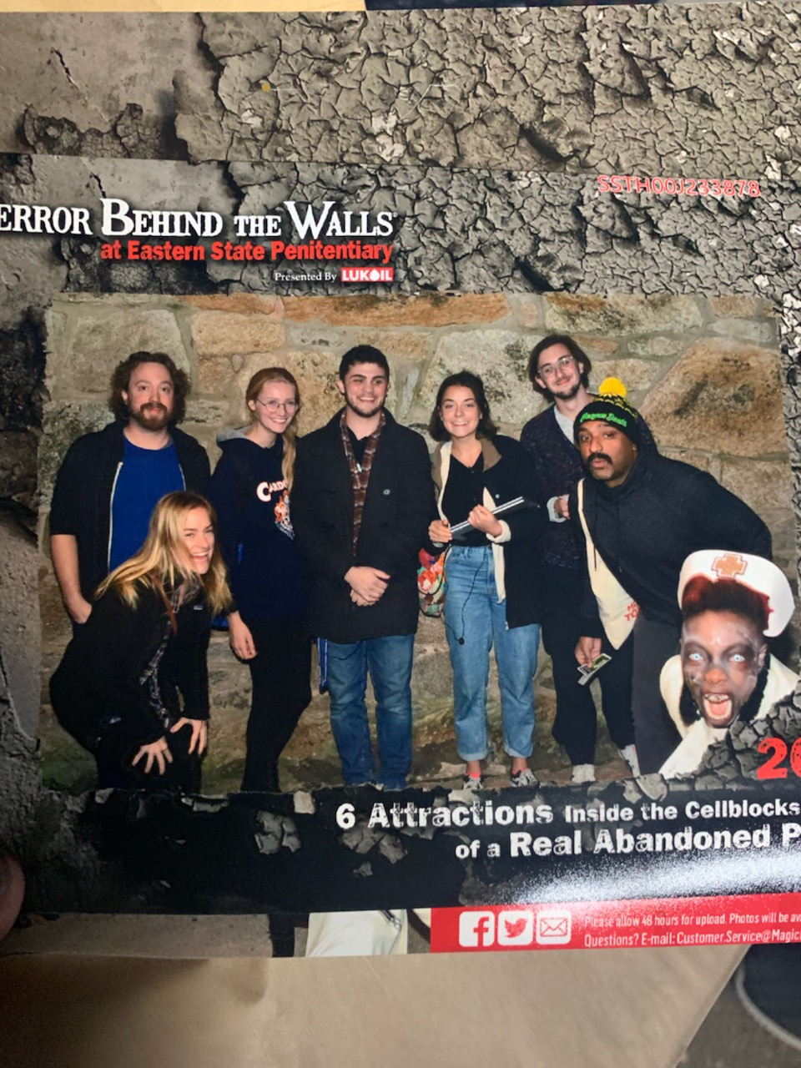

Sincere Appreciation to:
(Organized Alphabetically)
SAN Lab
Adhya Gowda
Chelsea Helion
Ian O’Shea
Helen Schmidt
Joanne Stasiak
AML Lab
Katelyn Cliver
Emily Cowan
Devlin Eckardt
Matthew Fain
Nicole Gonzalez
Dave Gregory
Kathryn Lockwood
Steven Martinez
Deepu Murty
Sam Reisman
Jane Rothrock
Notes:
Lastly, I just want to make sure to thank the people that helped me with this presentation and helped us build this project, between running sessions, data collections, scans, and analyzing. It really took a small army to pull off, and there were a lot of people that helped in big and small ways, so thank you to all of the members of the SAN Lab and the AML Lab.

Slide 80
QUESTIONS?

Slide 81




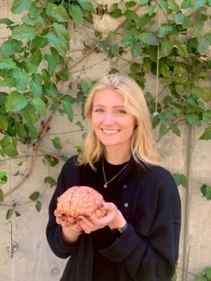





Principal Investigators
Chelsea Helion
Vishnu Murty
Temple University
Temple University
Joanne Stasiak
Billy Mitchell
Kate Cliver
David Gregory
Steven Martinez
Sam Reisman
UC Santa Barbara
Temple University
Drexel University
Temple University
Temple University
Brown University
‘How does physiological activation influence the metacognitive memory of emotional experiences over time?`
‘How do untrained people self-regulate high-intensity emotions?`
‘How do physiological representations of threat predict temporal memory?`
‘How does threat shape item-temporal memory binding?`
‘How does social media shape memory encoding for high intensity events?`
‘How does arousal and uncertainty intolerance bias episodic memory?`
Notes:
This is a very complicated question, because this project unfolded over several years with multiple people and multiple experiments.
In the original version of this talk I was actually going to touch briefly upon all of them
but I found myself running out of time just talking about the stuff that I led
So instead I’m just flashing some brief descriptions on the screen for you. These all are either preprints or published or in revision
So if you’re interested in hearing any more about them, let me know and I can talk about it at the end or direct you to the relevant materials

Slide 82
Setting: Eastern State Penitentiary in Philadelphia Pennsylvania 2019 (Study 1)
A ~45 minute haunted house experience divided into six distinctly-themed sections featuring dozens of actors on a pre-determined course filled with traps, fences, props, mazes, etc.

Slide 83
Setting: Eastern State Penitentiary in Philadelphia Pennsylvania 2022 (Study 2)
RENAMED
REMOVED
REMOVED
A ~35 minute haunted house experience divided into four distinctly-themed sections featuring dozens of actors on a pre-determined course filled with traps, fences, props, mazes, etc.

Slide 84




Data Collected
Physiology
Self-Report
Behavior
fMRI imaging

Slide 85
How am I conceptualizing threat in this context?
Setting Design
Labels made by creators
Number of relevant events
Self-Report
State STAI
Custom Measures
Cognitive Load (indirectly)
Physiology
Increased Heart Rate
Decreased Heart Rate Variability

Slide 86
Memory Under Threat
Memories under threat, broadly, are prone to distortions, while memory confidence often remains in tact
Threat-related arousal can bias individuals to forget contextual information linking peripheral information of an item to its surrounding context in memory

Slide 87
Memory Under Threat
Memories under threat, broadly, are prone to distortions, while memory confidence often remains in tact
Threat-related arousal can bias individuals to forget contextual information linking peripheral information of an item to its surrounding context in memory
Most research has focused on threat-related disruptions to item-spatial binding or item-item binding, but not item-temporal context binding.

Slide 88
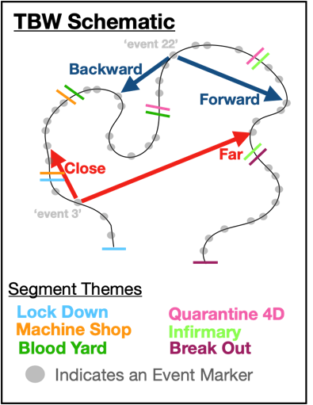
Memory Under Threat
Forward Transition
Proportion of events recalled backwards or forwards from last event in memory
Memories under threat, broadly, are prone to distortions, while memory confidence often remains in tact
Threat-related arousal can bias individuals to forget contextual information linking peripheral information of an item to its surrounding context in memory
Most research has focused on threat-related disruptions to item-spatial binding or item-item binding, but not item-temporal context binding.

Slide 89
Memory Under Threat
Forward Transition
Proportion of events recalled backwards or forwards from last event in memory
Memories under threat, broadly, are prone to distortions, while memory confidence often remains in tact
Threat-related arousal can bias individuals to forget contextual information linking peripheral information of an item to its surrounding context in memory
Most research has focused on threat-related disruptions to item-spatial binding or item-item binding, but not item-temporal context binding.

Slide 90
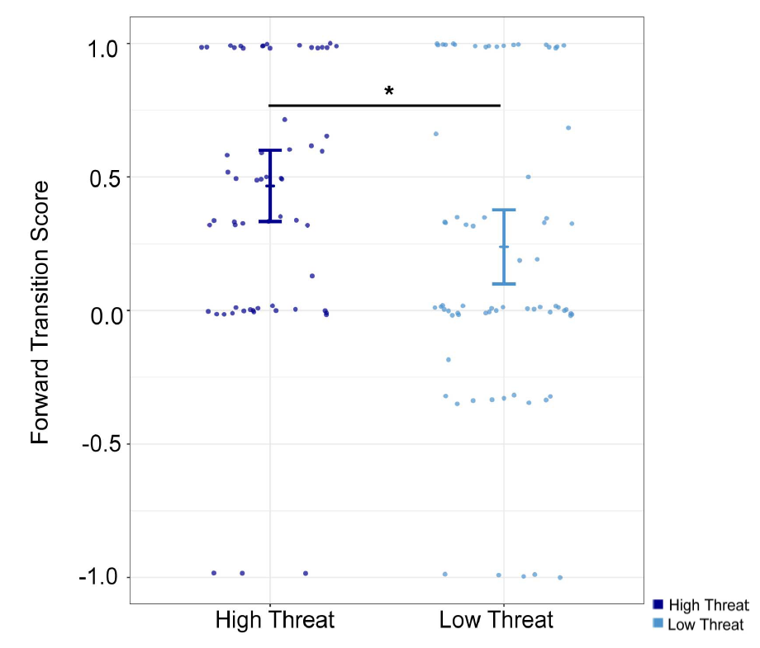
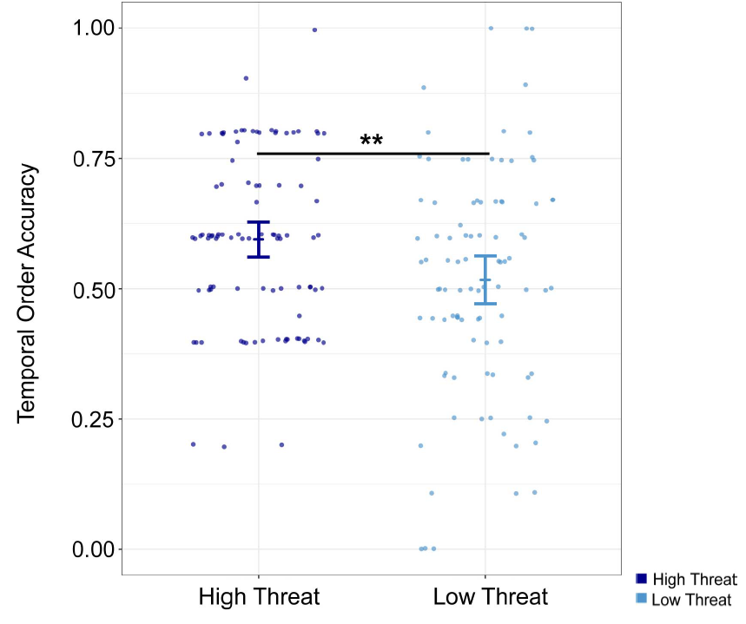
Threat improved temporal order memory (forward transitions in recall and recency discrimination judgments) ...
Forward Transition
Proportion of events recalled backwards or forwards from last event in memory

Slide 91
Threat improved temporal order memory (forward transitions in recall and recency discrimination judgments) ...
Forward Transition
Proportion of events recalled backwards or forwards from last event in memory

Slide 92
Threat improved temporal order memory (forward transitions in recall and recency discrimination judgments) ...
Forward Transition
Proportion of events recalled backwards or forwards from last event in memory

Slide 93
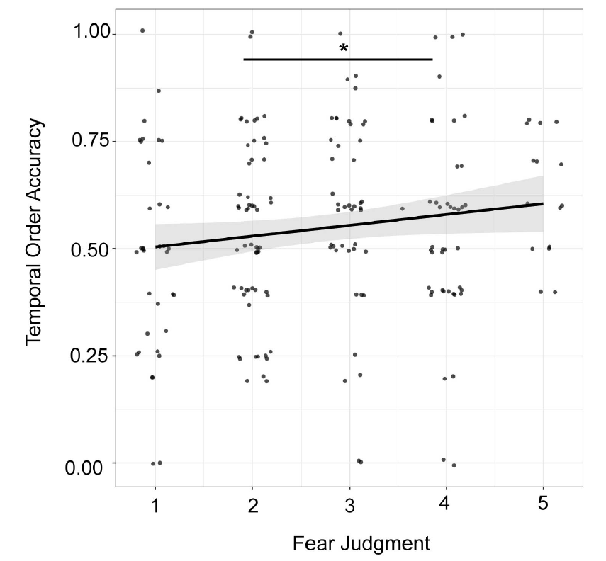
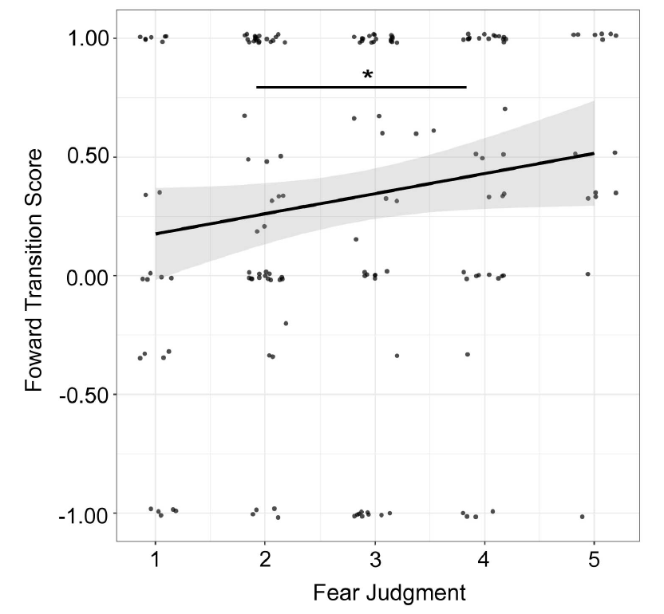
Threat improved temporal order memory (forward transitions in recall and recency discrimination judgments) ...
Forward Transition
Proportion of events recalled backwards or forwards from last event in memory
… and this was true using either objective measures of threat (i.e., pre-determined segments of the haunted house) or individually specific subjective measures of threats (i.e., fear judgments)

Slide 94
Threat improved temporal order memory (forward transitions in recall and recency discrimination judgments) ...
Forward Transition
Proportion of events recalled backwards or forwards from last event in memory
… and this was true using either objective measures of threat (i.e., pre-determined segments of the haunted house) or individually specific subjective measures of threats (i.e., fear judgments)

Slide 95

What did this project teach us happens …
During threats
After threats
Emotion regulation is complex and colored by environmental affordances
Memory accuracy improves for some things and worsens for others
Memory for temporal order and item-temporal order context actually seems to improve under threat

Slide 96
Emotional Memory Under Threat
Stimuli with emotional meaning tend to be remembered more often, and more accurately, than neutral stimuli
Elevated heart rate has been linked to enhanced autobiographical memory and increased recall accuracy for emotion-eliciting stimuli

Slide 97
Emotional Memory Under Threat
Stimuli with emotional meaning tend to be remembered more often, and more accurately, than neutral stimuli
Elevated heart rate has been linked to enhanced autobiographical memory and increased recall accuracy for emotion-eliciting stimuli
High levels of Norepinephrine – a primary neurotransmitter produced during stress – are associated with enhanced memory for emotional stimuli.

Slide 98
Emotional Memory Under Threat
Stimuli with emotional meaning tend to be remembered more often, and more accurately, than neutral stimuli
Elevated heart rate has been linked to enhanced autobiographical memory and increased recall accuracy for emotion-eliciting stimuli
High levels of Norepinephrine – a primary neurotransmitter produced during stress – are associated with enhanced memory for emotional stimuli.
Individuals report decreased intensity when applying discrete emotion labels to affective images relative to when the images are viewed without being labeled.

Slide 99
Emotional Memory Under Threat
Stimuli with emotional meaning tend to be remembered more often, and more accurately, than neutral stimuli
Elevated heart rate has been linked to enhanced autobiographical memory and increased recall accuracy for emotion-eliciting stimuli
High levels of Norepinephrine – a primary neurotransmitter produced during stress – are associated with enhanced memory for emotional stimuli.
Individuals report decreased intensity when applying discrete emotion labels to affective images relative to when the images are viewed without being labeled.

Slide 100
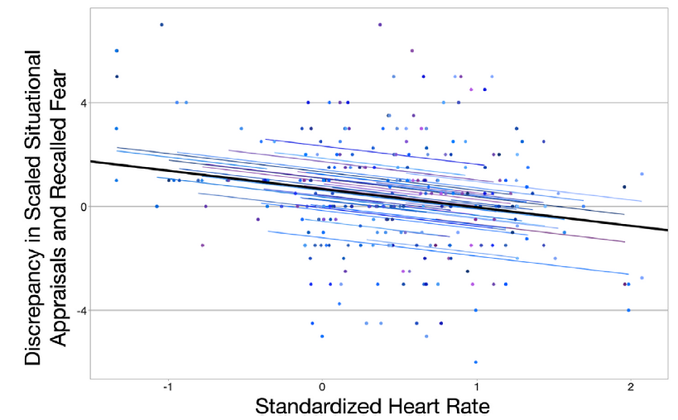
Emotional Memory Under Threat
Heart rate predicted both the intensity of reported scariness in the haunted house and meta-cognitive memory of affect during recall

Slide 101
Emotional Memory Under Threat
Heart rate predicted both the intensity of reported scariness in the haunted house and meta-cognitive memory of affect during recall

Slide 102
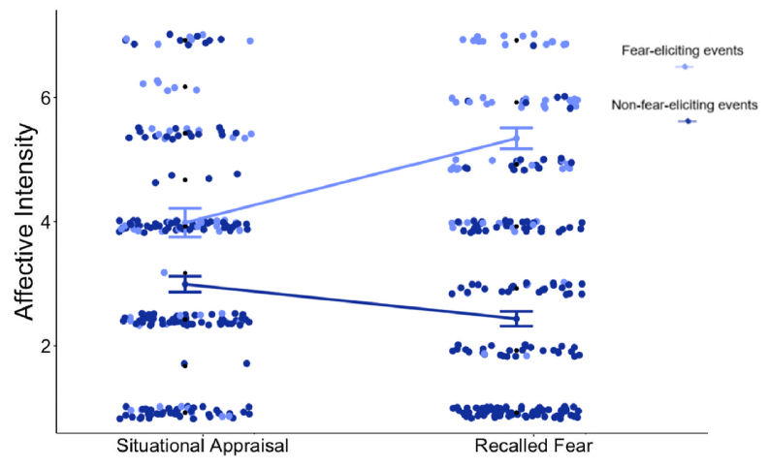
Emotional Memory Under Threat
Heart rate predicted both the intensity of reported scariness in the haunted house and meta-cognitive memory of affect during recall
Metacognitive emotional memory was malleable based on how the event was initially labeled.

Slide 103
Emotional Memory Under Threat
Heart rate predicted both the intensity of reported scariness in the haunted house and meta-cognitive memory of affect during recall
Metacognitive emotional memory was malleable based on how the event was initially labeled.

Slide 104
Emotional Memory Under Threat
Heart rate predicted both the intensity of reported scariness in the haunted house and meta-cognitive memory of affect during recall
Metacognitive emotional memory was malleable based on how the event was initially labeled.
Individuals tended to recall events that they explicitly labeled as fear-evoking as being more intense than they reported at the time of the event.

